Slide 1
System Hacks:
Tips and Tricks for Beginners and Beyond
Alejandro Aguilar
Imperial Valley College

Slide 2

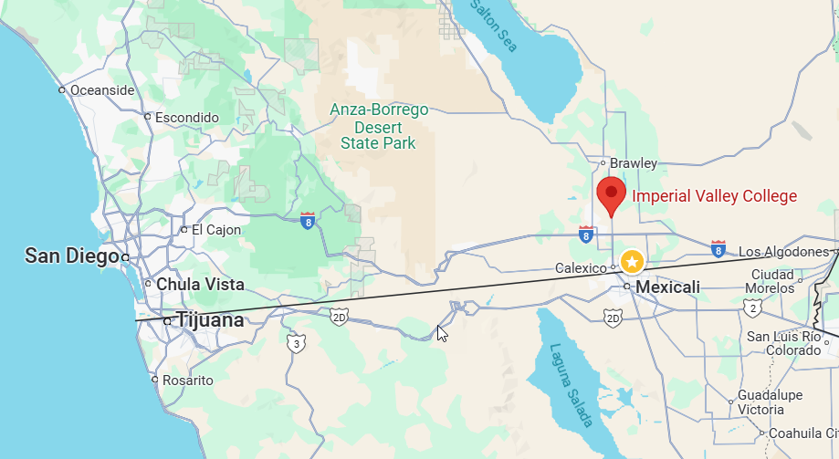

A little bit about me …
Alex Aguilar
Imperial Valley College
Systems Architect
Located in Imperial, CA
7,747 FTES
Hispanic Serving Institution (HIS)
Single-Campus District
Argos since 2007

Slide 3

Agenda
Datablocks & APIS
Web Viewer
Reports & Schedules
Electronic Forms
MAPS Security
SQL
Questions?
Thank you
Notes:
Some of these ‘hacks’ require additional permissions in Argos and/or the Database

Slide 4
Datablocks & APIs

Slide 5
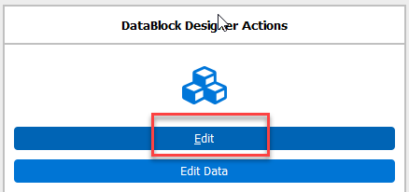
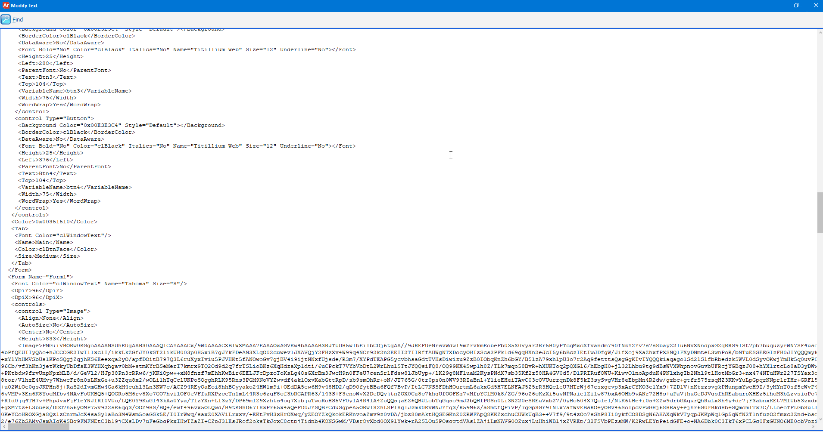

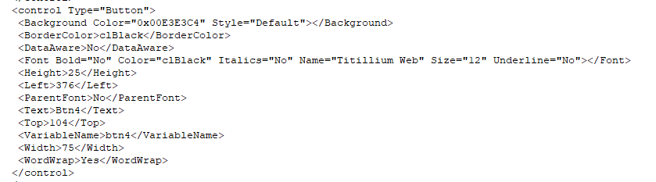
EDIT DATA
[ datablocks & apis]
D
Notes:
Useful to update multiple objects at once
Powerful but fragil

Slide 6
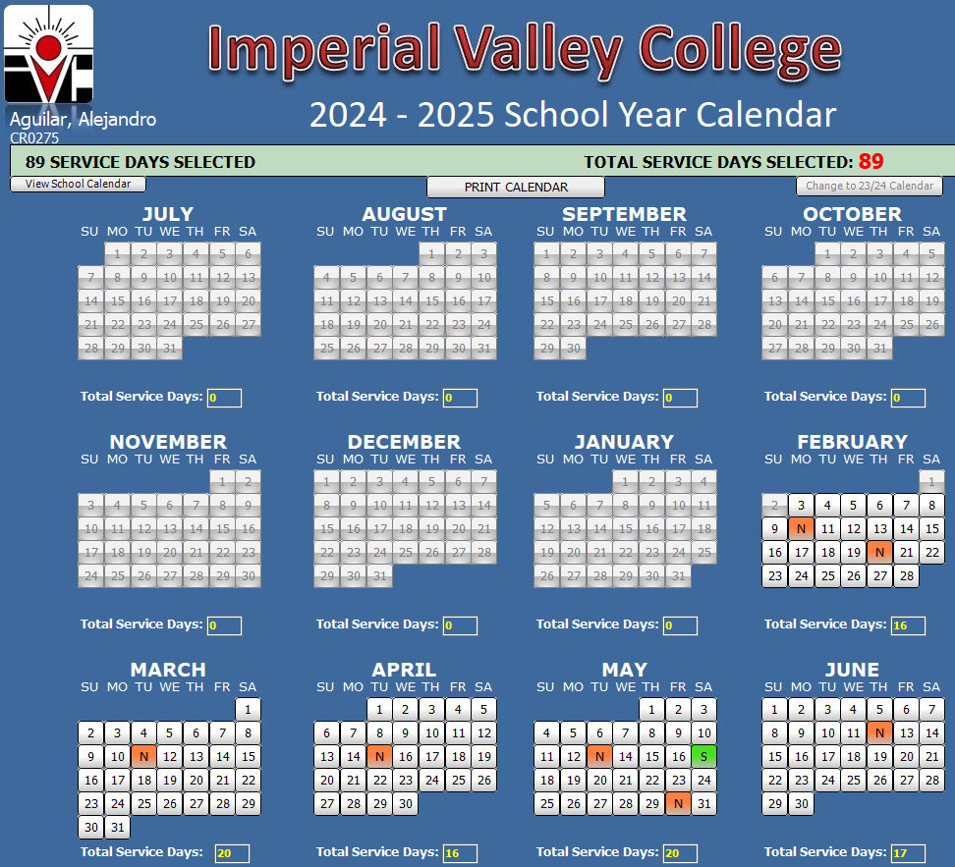

[ datablocks & apis]
12 months
37 days p/month
3 buttons /day
444 buttons p/year
1332 total buttons
Notes:
Changed colors quickly with Edit Data functionality

Slide 7
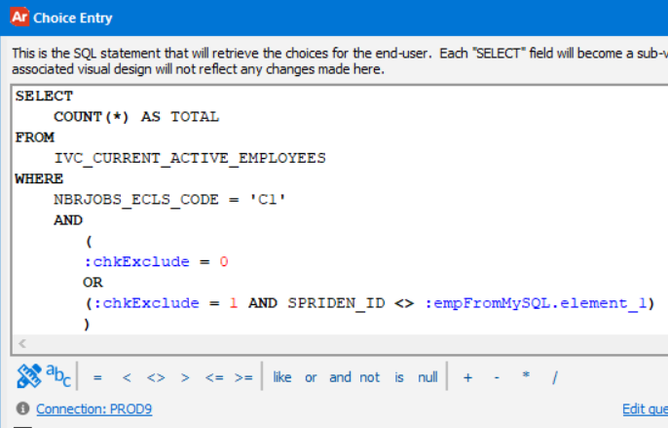
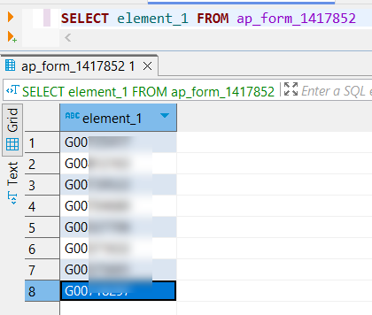

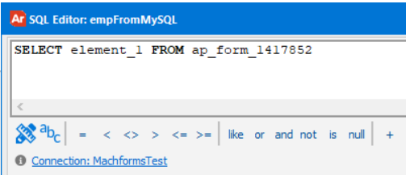
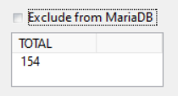
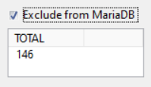
Filtering MCB with data from another DB
[ datablocks & apis]
Employee list in MySQL
Employee Info from Banner (Oracle)
Same multicolumn box
Oracle (Banner)
mySQL
Notes:
Employee list from mySQL
Employee count from Oracle (Banner)
Where clause in Oracle using a variable from mySQL

Slide 8
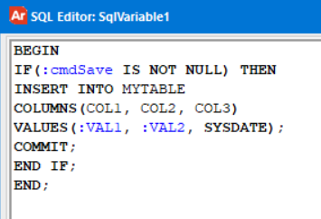
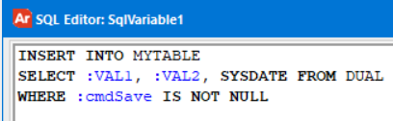

Insert/Delete/Update Database
[ datablocks & apis]
Using Argos variables
Must use a DDL-enabled connection
Notes:
Two ways to INSERT in Argos

Slide 9

Insert/Delete/Update Database
[ datablocks & apis]
Using database Function
No need for a DDL-enabled connection
Select function(param) as Result from dual
Error Handling
Rollback on certain conditions
Reusable across multiple datablocks
(one update to the function reflects to all datablocks)

Slide 10
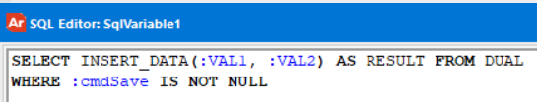
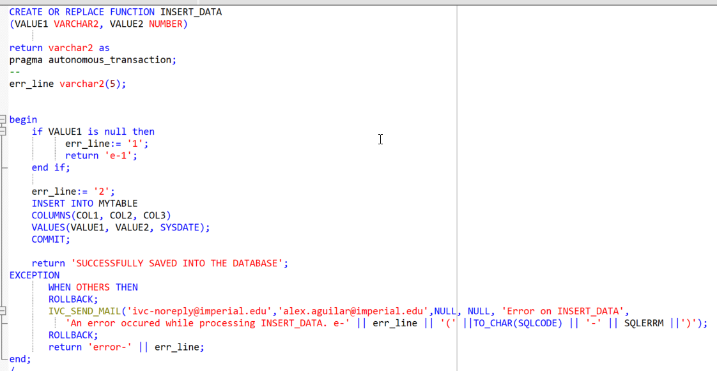

Insert/Delete/Update Database
[ datablocks & apis]
Using database Function
Download sample: https://www.alexdeux.com/evisions
Notes:
Example
Sample downloadable at https://www.alexdeux.com/evisions

Slide 11
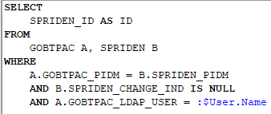
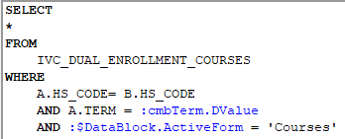

[ datablocks & apis]
SYSTEM VARIABLES
Personalized content
Datablocks more efficient
(loads faster)
$User.Name
$DataBlock.ActiveForm
Notes:
Use of system variables can help make your datablock more efficient and personalized

Slide 12
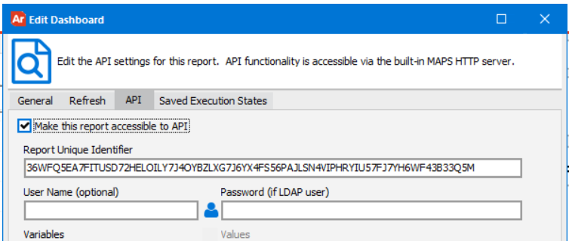

Direct links to datablocks/reports
[ datablocks & apis]
with parameters
API
Syntax: https://argosServer/argos/index..html?report=<ApiCode>&param1=X&param2=Y
Example: https://evisions.imperial.edu/argos/index.html?report=36WFQ5EA7FITUSD72HELOILY7J4OYBZLXG7J6YX4FS56PAJLSN4VIPHRYIU57FJ7YH6WF43B33Q5M&param1=Evisions&param2=Conference
Notes:
API with client and parameters

Slide 13

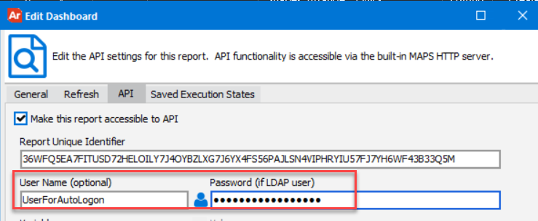
Direct links to datablocks/reports
[ datablocks & apis]
with parameters and auto logon
API
Syntax: https://argosServer/argos/index..html?report=<ApiCode>&param1=X&param2=Y&autologon
Example: https://evisions.imperial.edu/argos/index.html?report=36WFQ5EA7FITUSD72HELOILY7J4OYBZLXG7J6YX4FS56PAJLSN4VIPHRYIU57FJ7YH6WF43B33Q5M&param1=Evisions&param2=Conference &autologon
Notes:
API with client, parameters and automatic login

Slide 14
Modifying a production Datablock
[ datablocks & apis]
Maintaining the same API code
Scenario
Datablock is in PROD
It has an API that people uses
(ex. https://evisions.imperial.edu/argos/index.html?report=PBB7GEZYVNTVKNQUHVPNPPXOFDVWXFRHATER2B6OPNIZBVY4MSVKOG7VXIYYAHAOR5OXG7TZ4S5VU)
Substantial changes are required
We want to maintain the same API to keep the same shortcut
Solution
Make a copy of the original Datablock (O)
Make all the required modifications in the Datablock Copy (C)
and test that it works as expected
Use EDIT DATA on Datablock (C), copy the code and close.
Use EDIT DATA on Datablock (O), paste the code and close.
Delete Datablock (C)
Notes:
If you need to modify a datablock that has an API already generated, make a copy of the datablock and use the EDIT data functionality to copy the updated datablock into the original one.

Slide 15
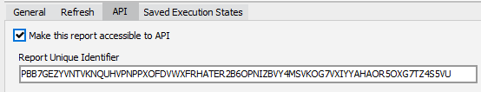
Modifying a production Datablock
[ datablocks & apis]
Maintaining the same API code
Original
Copy
API remains the same!
Notes:
If you need to modify a datablock that has an API already generated, make a copy of the datablock and use the EDIT data functionality to copy the updated datablock into the original one.

Slide 16
Web Viewer

Slide 17
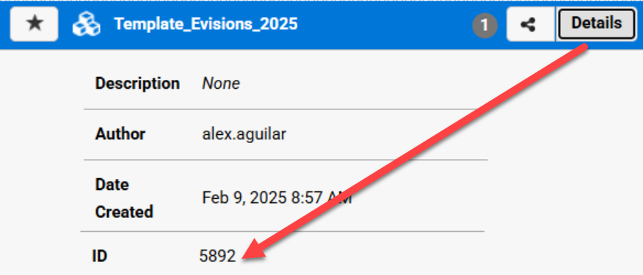

Direct links to datablocks/reports
[ WebViewer ]
Web Viewer
Syntax: https://argosServer/argos/awv/#DataBlock=<DataBlockID>&Hash=param1|param2
Example: https://evisions.imperial.edu/argos/awv/#DataBlock=5892 &Hash=X|Y
* Parameters are received in a textbox named “incoming_hash_txt”
Notes:
Use Datablock ID to form the URL

Slide 18

Direct links to datablocks/reports
[ WebViewer ]
with parameters and autologon
Web Viewer
Syntax: https://phpServer/api.php?id=<DataBlockID>&hash=params
Example: https://php.imperial.edu/api.php?id=5892&hash=Evisions|Conference
* Parameters are received in a textbox named “incoming_hash_txt”
* Samples available at evisions.com for PHP, Ruby & Python
https://support.evisions.com/s/article/Argos-Web-Viewer-API-Specification
Notes:
No Autologon with WebViewer
Must use a PHP or similar page to create token and pass parameters

Slide 19
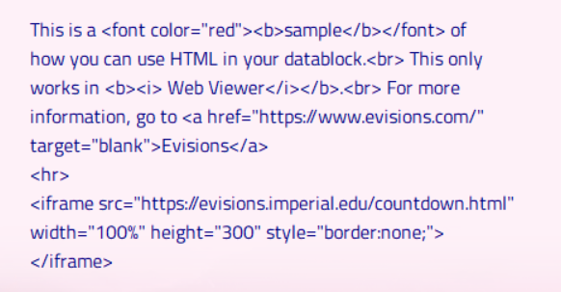
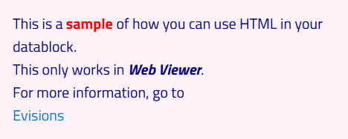


HTML in Web Viewer
[ WebViewer ]
Argos Client
Argos Web Viewer
Notes:
Take advantage of WebViewer to display HTML

Slide 20
Reports & Schedules

Slide 21

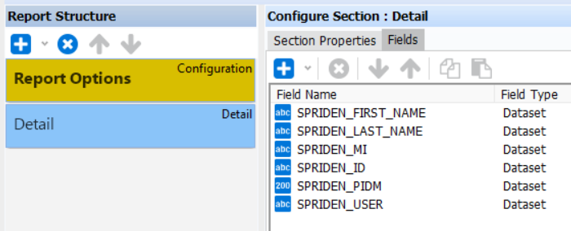
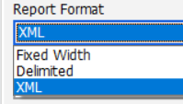
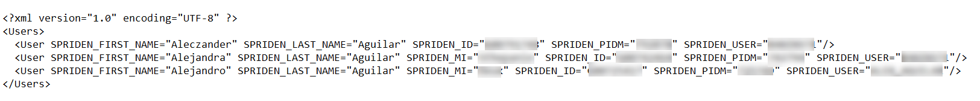
XML / JSON Output
[ reports & schedules ]
Already in Argos
Extract Report
Notes:
XML is Organic to Argos

Slide 22
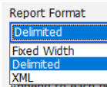
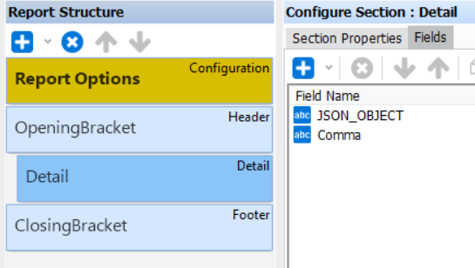
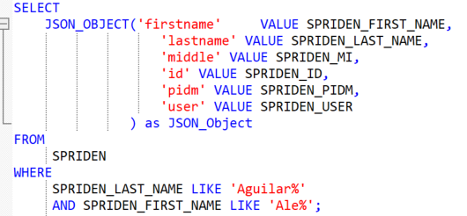

XML / JSON Output
[ reports & schedules ]
Not in Argos
Oracle’s JSON_OBJECT
+
Extract report (delimited)
Download sample: https://www.alexdeux.com/evisions
Notes:
There’s a way to have a JSON output combining Oracle and Argos
Sample downloadable at https://www.alexdeux.com/evisions

Slide 23

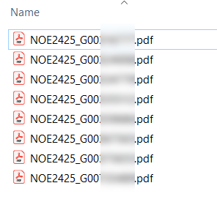

Schedules - Bursting
[ reports & schedules ]
Regular Schedule
Schedule with Bursting
One single PDF
8 pages (1 per employee)
Split and rename individually
to employee ID
8 different PDFs
1 per employee
Ready to upload
Notes:
Bursting can help to automate the task of splitting one document into multiple

Slide 24
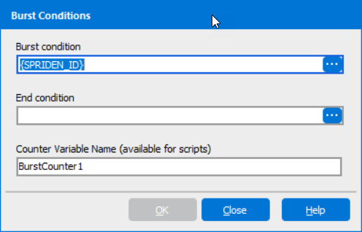
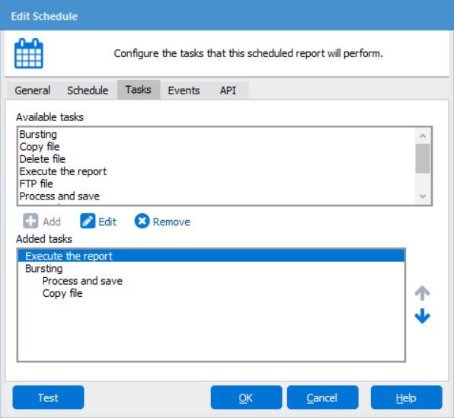


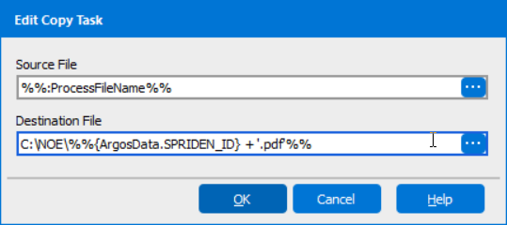
Schedules - Bursting
[ reports & schedules ]
Setup
[Schedule with Bursting]
[Regular Schedule]

Slide 25

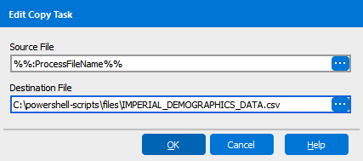
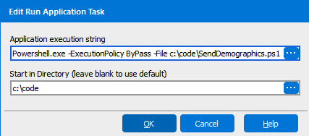

Schedules – Powershell Scripts
[ reports & schedules ]
Pros
Real-life Application
Automation & Efficiency
Enhanced Integration
Error handling
Logging
Get student info from Banner
Generate CSV file
Copy file to server location
Run PS Script to upload to 3rd party
Download sample: https://www.alexdeux.com/evisions
Notes:
Powershell Scripts can be a powerful tool in a Schedule to do more things asynchronously
Sample downloadable at https://www.alexdeux.com/evisions

Slide 26
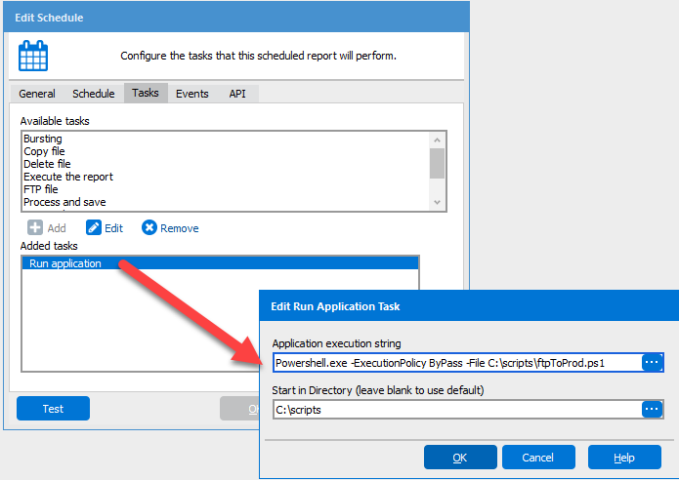
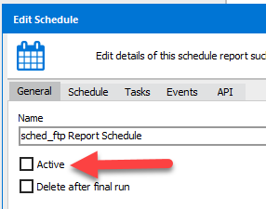
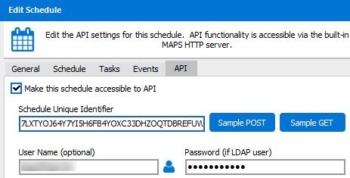

Schedules not scheduled?
[ reports & schedules ]
Called On-Demand
(not active)
Uses API
https://evisions.imperial.edu/mrr?schedule=YOXC3VGWBIIKFHEK7LXTYOJ64Y7YI5H6FB4RXKYANJI4W&Param1=Value1
Notes:
You can run a schedule with an API

Slide 27
Electronic Forms

Slide 28
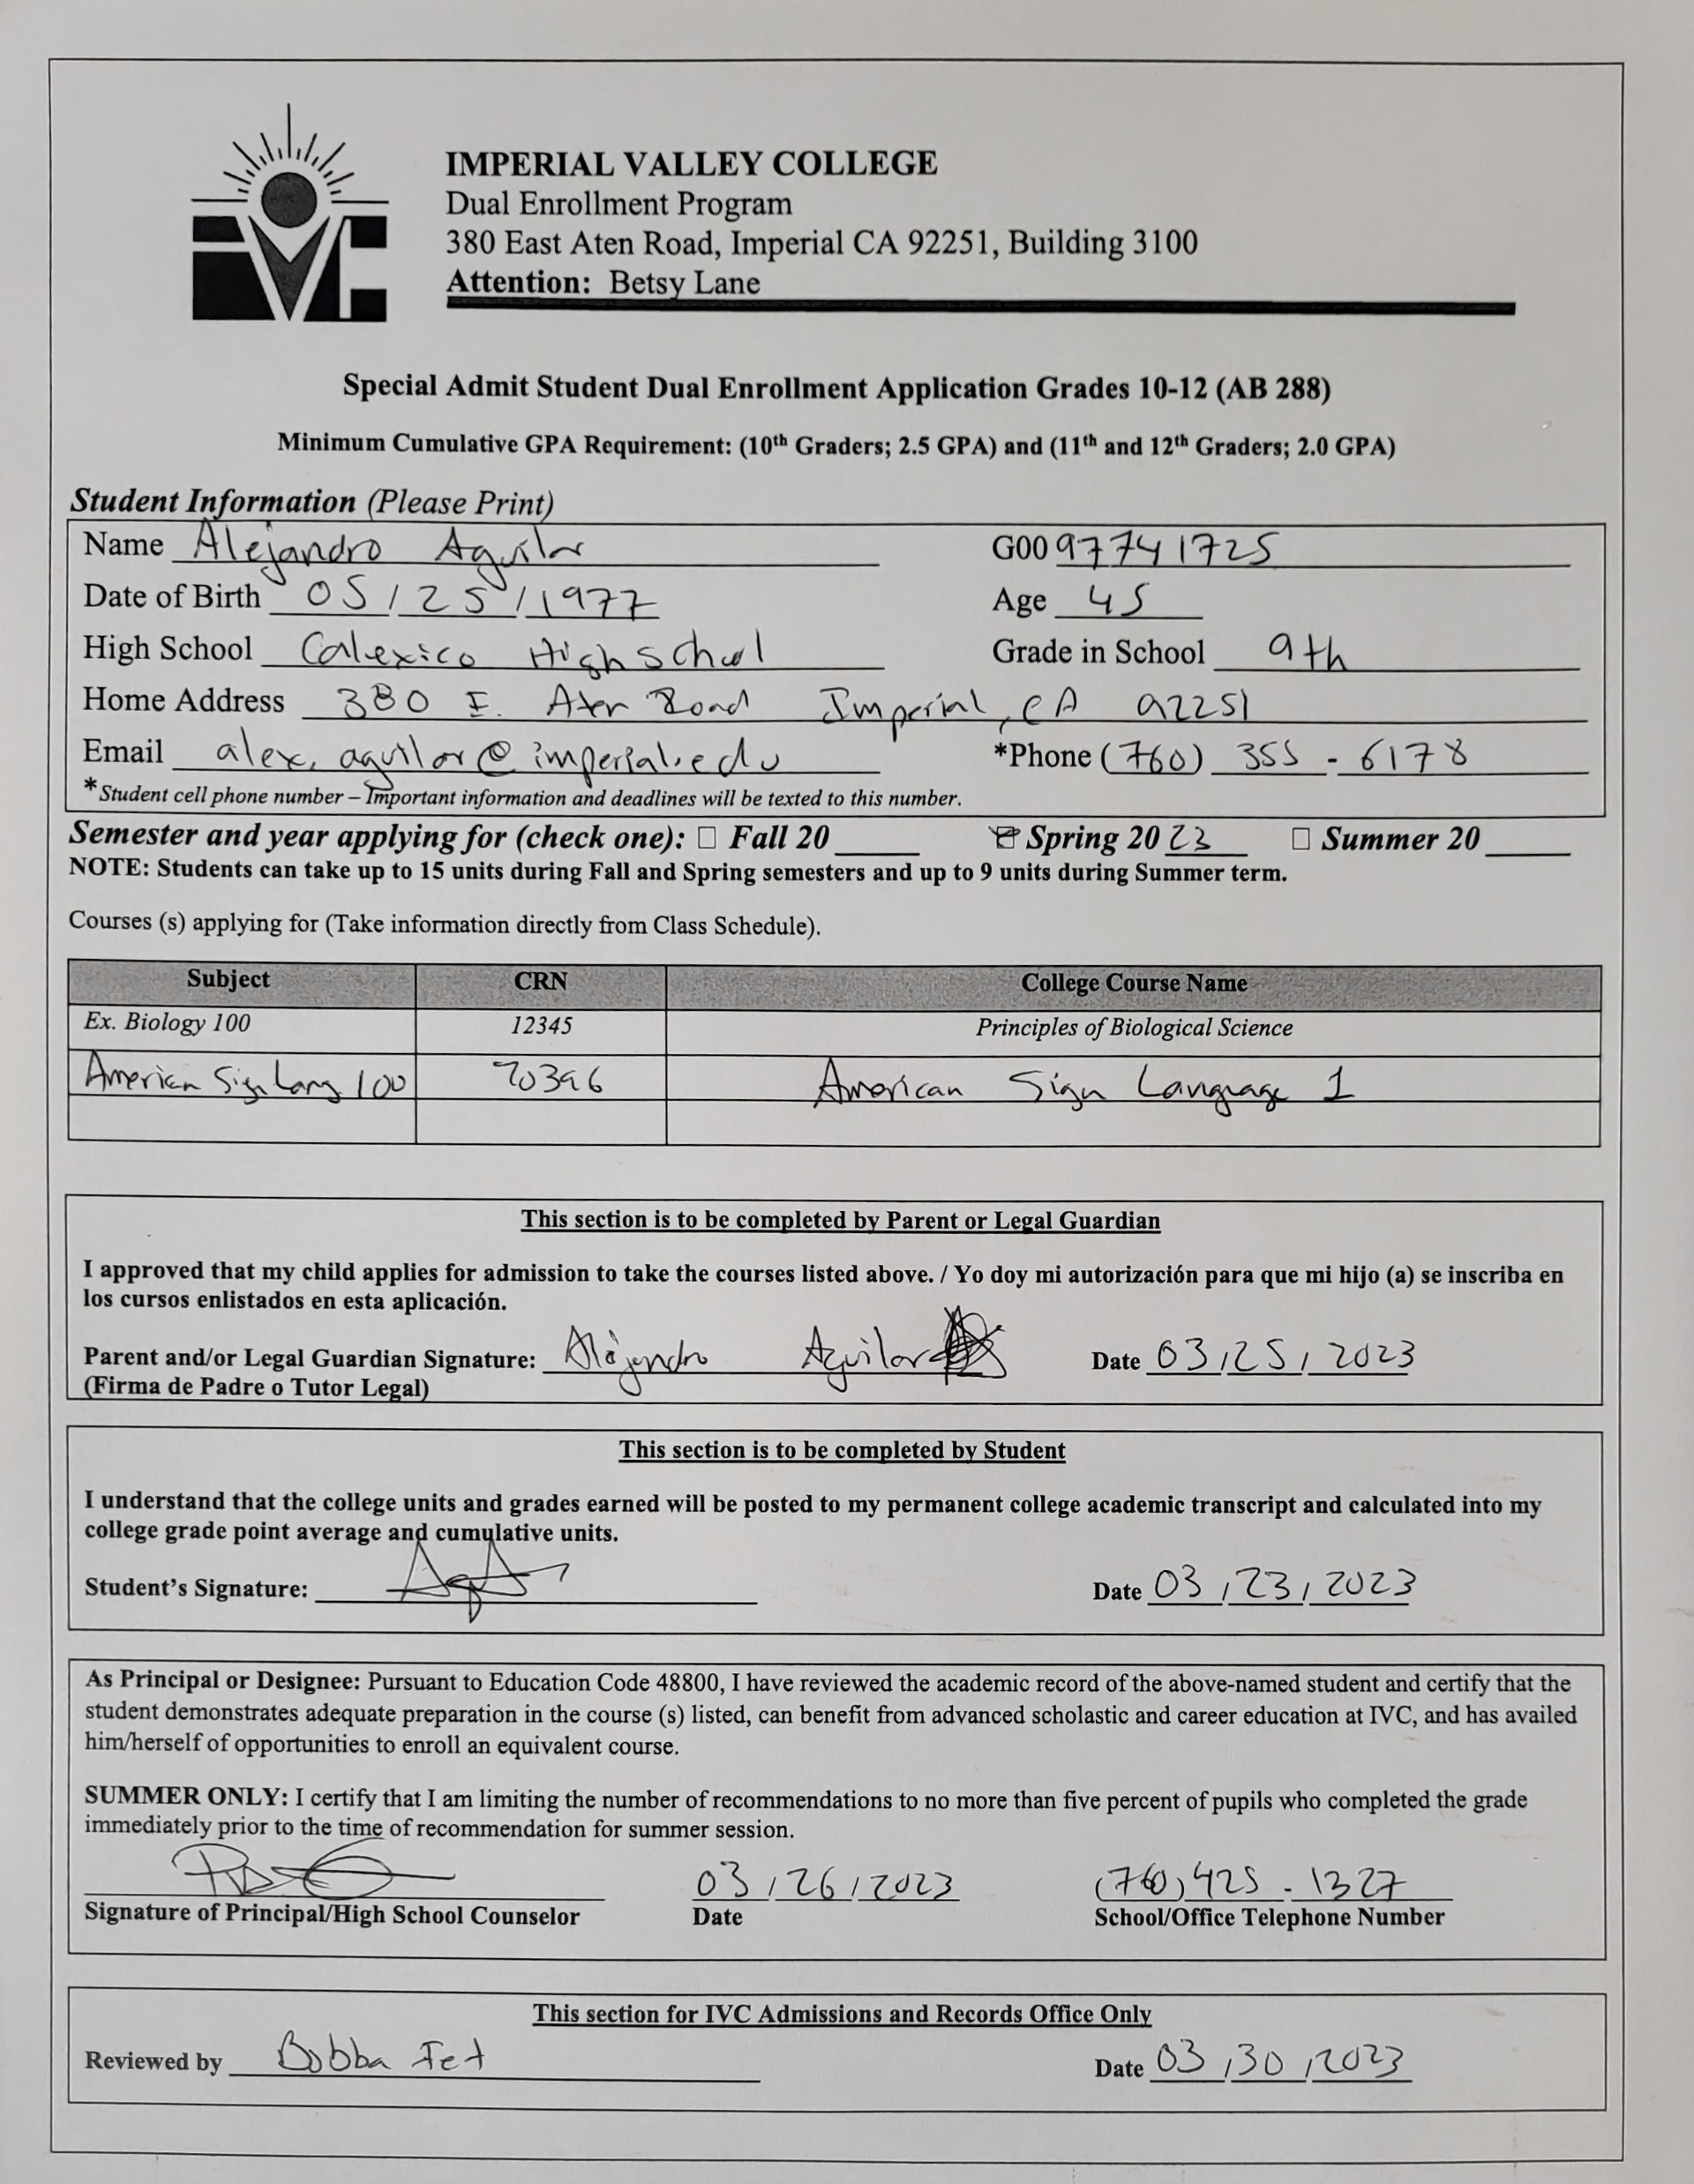
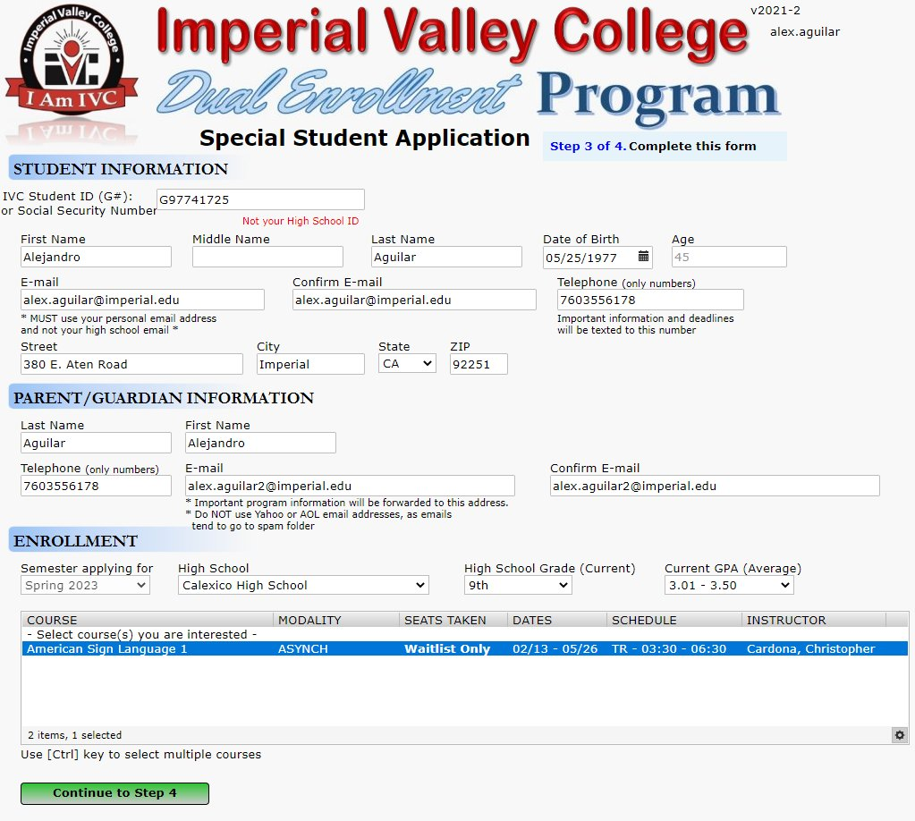

Electronic Forms
[ electronic forms ]
Notes:
Use Argos to input data, not just for reporting

Slide 29



Overall Electronic Forms Process
[ electronic forms ]
Filling out
Submitting
Approval
Notifications
:$User.Name for identity
Multiple Data Sources
SQL Variables
Fields Validation
INSERT with function
Email notification within function
Error Handling
Approvers from Banner
(e.g. NTRRQUE, NBAJQUE, NBAPOSN)
Approval SQL function to UPDATE database
Email notifications within function

Slide 30
MAPS Security

Slide 31

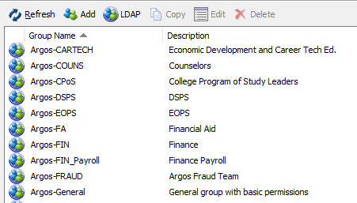
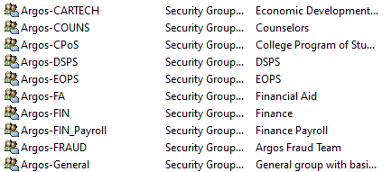
MAPS Groups / Users
[ maps security ]
MAPS
AD Users
AD Groups
Notes:
You don’t need to create a user for every employee
As long as they are assigned to an AD Group
And that AD Group is in MAPS

Slide 32
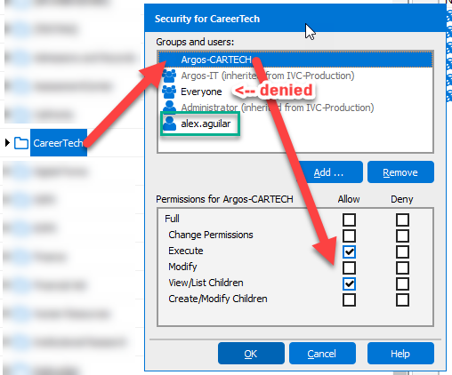

MAPS Groups / Users
[ maps security ]
Before:
300+ MAPS users
After:
< 40 MAPS users
User provision automatic vs manual
Notes:
You can set the appropriate permissions per group and it will propagate to the users

Slide 33
SQL

Slide 34
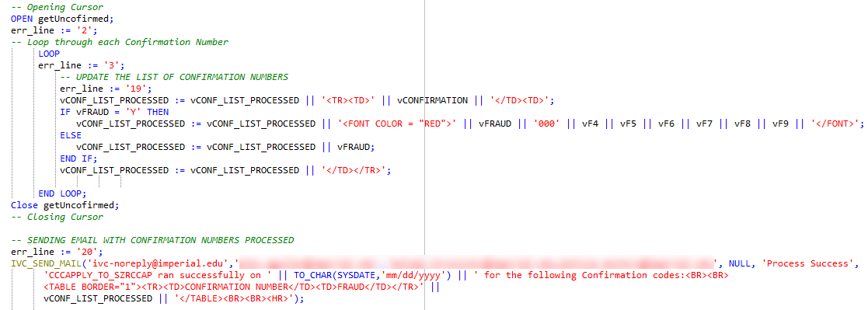
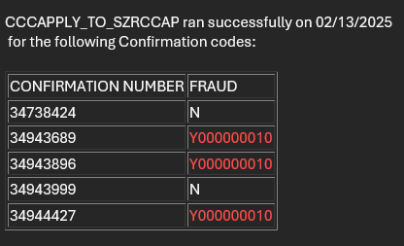

Email HTML Tables with SQL
[ sql ]
Output
Source

Slide 35
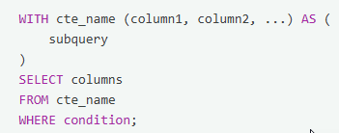
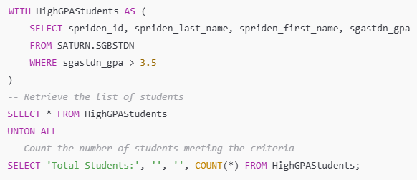

WITH SQL Clause
[ sql ]
Benefits
Syntax
Example
Simplifying complex queries
Enhancing query readability and maintainability
Avoids redundant code
Notes:
WITH clause can simplify a query
Not necessarily make it more efficient as-is

Slide 36

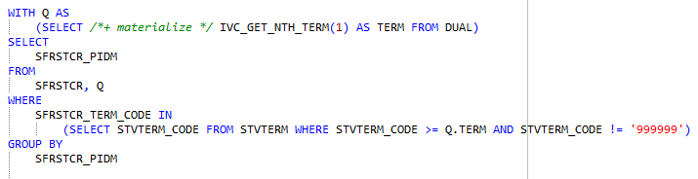
WITH SQL Clause + hint
[ sql ]
MATERIALIZE – Forces Oracle to store the results (prevents multiple scans).
SELECT IVC_GET_NTH_TERM(1) AS TERM FROM DUAL
48 seconds
SELECT /*+ materialize */ IVC_GET_NTH_TERM(1) AS TERM FROM DUAL
0.19 seconds
Notes:
/*+ materialize */ hint forces the database engine to store results in memory
It reuses the stored data making it more efficient on run-time

Slide 37


Questions?
Notes:
Thank you for attending!

Slide 38
Thank you!
Alejandro Aguilar
Imperial Valley College
alex.aguilar@imperial.edu
Notes:
Don’t hesitate to contact me for any questions you may have after the session!

